Slide 1

INFORMATION SYSTEMS, ORGANIZATIONS, AND STRATEGY
Chapter 3
VIDEO CASES
Case 1: National Basketball Association: Competing on Global Delivery With Akamai OS Streaming
Case 2: Customer Relationship Management for San Francisco's City Government

Slide 2
CHAPTER 3: INFORMATION SYSTEMS, ORGANIZATIONS,
AND STRATEGY
Learning Objectives
Identify and describe important features of organizations that managers need to know about in order to build and use information systems successfully.
Demonstrate how Porter’s competitive forces model helps companies develop competitive strategies using information systems.
Explain how the value chain and value web models help businesses identify opportunities for strategic information system applications.
© Prentice Hall 2011
Notes:
You could ask students to recall some concepts from the previous chapters that might help managers build and use information systems successfully. Answers could include what business processes the company performs, the size of the company, or the organization of the information systems function.

Slide 3
CHAPTER 3: INFORMATION SYSTEMS, ORGANIZATIONS,
AND STRATEGY
Learning Objectives (cont.)
Demonstrate how information systems help businesses use synergies, core competencies, and network-based strategies to achieve competitive advantage.
Assess the challenges posed by strategic information systems and management solutions.
© Prentice Hall 2011
Notes:
Recall the business objectives that allow firms to achieve competitive advantage discussed in Chapter 1: operational excellence, new products, services and business models, customer and supplier intimacy, and improved decision making.

Slide 4
CHAPTER 3: INFORMATION SYSTEMS, ORGANIZATIONS,
AND STRATEGY
Verizon or AT&T: Which Company Has the Best Digital Strategy?
Problem: High-stakes competition in the wireless market
Solutions:
  AT&T is marketing leading-edge devices
    Has 43% of U.S. smartphone users, but poorer network
  Verizon is investing in updating, expanding, and improving network
    Fewer smartphone customers, but most reliable in U.S.
Demonstrates IT’s central role in defining competitive strategy
© Prentice Hall 2011
Notes:
This case illustrates how firms in the very same industry (telecommunications) can pursue very different objectives and technologies. One company has a superior network, while the other company has superior devices.
Ask students what their experience has been, using smart phones, smart phone services, and whether they have used AT&T or Verizon. Which of the two strategies examined do students think is most likely to succeed? Ask them what services from a mobile provider they consider most important. What services would make them switch to a different provider?

Slide 5
CHAPTER 3: INFORMATION SYSTEMS, ORGANIZATIONS,
AND STRATEGY
Organizations and Information Systems
Information technology and organizations influence one another
  Complex relationship influenced by organization’s
    Structure
    Business processes
    Politics
    Culture
    Environment, and
    Management decisions
© Prentice Hall 2011
Notes:
This concept was briefly discussed in Chapter 1. Figure 1-2 and 1-3 as well as the figure on the next slide, 3-1, display this interdependent relationship graphically.

Slide 6
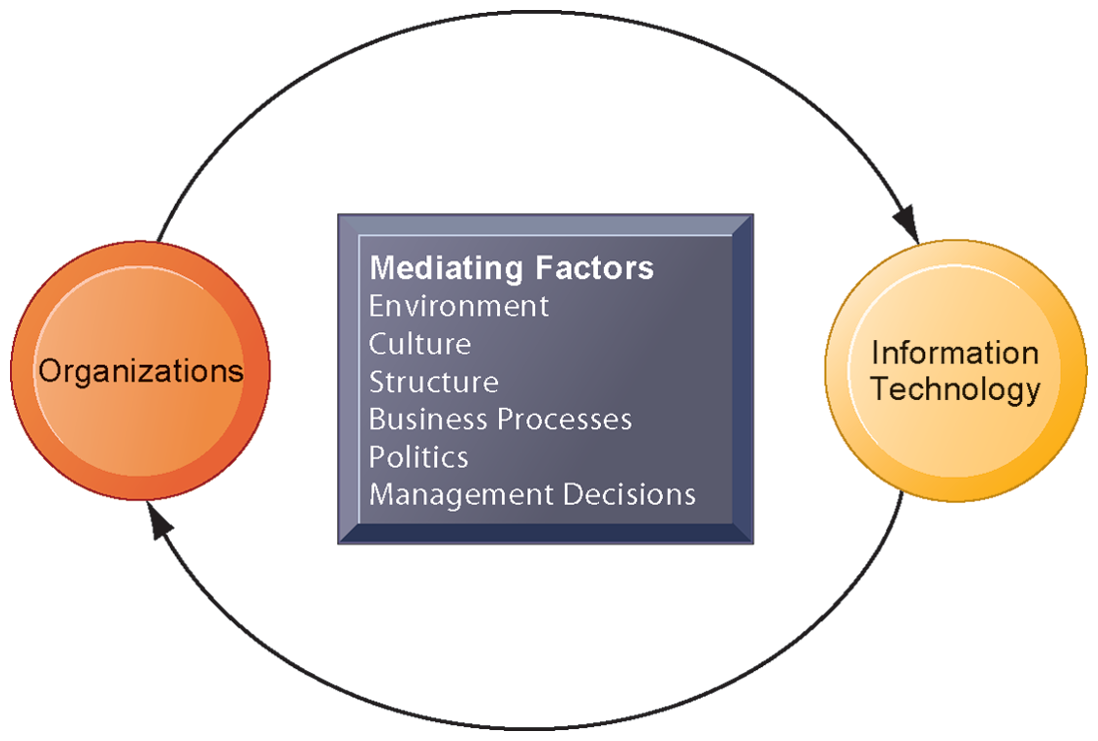
CHAPTER 3: INFORMATION SYSTEMS, ORGANIZATIONS,
AND STRATEGY
Organizations and Information Systems
THE TWO-WAY RELATIONSHIP BETWEEN ORGANIZATIONS AND INFORMATION TECHNOLOGY
This complex two-way relationship is mediated by many factors, not the least of which are the decisions made—or not made—by managers. Other factors mediating the relationship include the organizational culture, structure, politics, business processes, and environment.
FIGURE 3-1
© Prentice Hall 2011
Notes:
Ask students to explain how each factor might affect the relationship between organizations and information technology. Emphasize to students that the relationship between these two and its effects on the future of a business are difficult to predict. For example, very few people could have predicted the prominence of e-mail and instant messaging in business communication 15 years ago.

Slide 7
CHAPTER 3: INFORMATION SYSTEMS, ORGANIZATIONS,
AND STRATEGY
Organizations and Information Systems
What is an organization?
  Technical definition:
    Stable, formal social structure that takes resources from environment and processes them to produce outputs
    A formal legal entity with internal rules and procedures, as well as a social structure
  Behavioral definition:
    A collection of rights, privileges, obligations, and responsibilities that is delicately balanced over a period of time through conflict and conflict resolution
© Prentice Hall 2011
Notes:
Which of the two definitions do students find more accurate and why? It is important to consider both definitions rather than exclusively use one at the expense of the other. The two definitions are complementary.

Slide 8
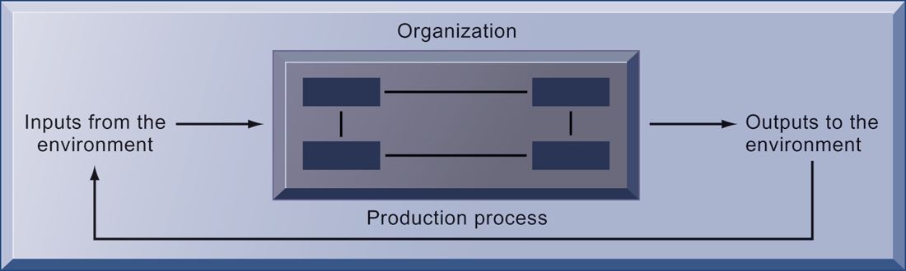
CHAPTER 3: INFORMATION SYSTEMS, ORGANIZATIONS,
AND STRATEGY
Organizations and Information Systems
THE TECHNICAL MICROECONOMIC DEFINITION OF THE ORGANIZATION
FIGURE 3-2
In the microeconomic definition of organizations, capital and labor (the primary production factors provided by the environment) are transformed by the firm through the production process into products and services (outputs to the environment). The products and services are consumed by the environment, which supplies additional capital and labor as inputs in the feedback loop.
© Prentice Hall 2011
Notes:
Ask students what are the inputs from the environment? What do organizations output (goods and services). In this view, the organization or business firm is rather easily changed, and malleable. The organization is a collection of parts, like a machine, that can be re-arranged as needed. There are no humans in this model, or if there are, they are assumed to be relatively simple.

Slide 9
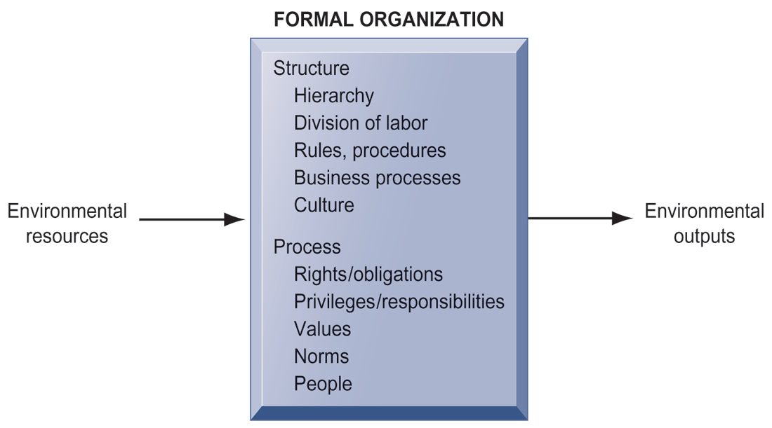
CHAPTER 3: INFORMATION SYSTEMS, ORGANIZATIONS,
AND STRATEGY
Organizations and Information Systems
THE BEHAVIORAL VIEW OF ORGANIZATIONS
FIGURE 3-3
The behavioral view of organizations emphasizes group relationships, values, and structures.
© Prentice Hall 2011
Notes:
In this view, the business firm is a little more difficult to change rapidly or on command because it is a very complex machine populated with human beings. Firms operate with an existing hierarchy, job definitions, business rules, legeal contracts, procedures and processes. Efficient organizations become very good at these elements of business. Changing these elements takes more time.

Slide 10
CHAPTER 3: INFORMATION SYSTEMS, ORGANIZATIONS,
AND STRATEGY
Organizations and Information Systems
Features of organizations
    Use of hierarchical structure
    Accountability, authority in system of impartial decision making
    Adherence to principle of efficiency
    Routines and business processes
    Organizational politics, culture, environments and structures
© Prentice Hall 2011
Notes:
You could ask students to envision what would happen to an organization that did not use a hierarchical structure (would anything get done?), did not adhere to the principle of efficiency (would they provide any good or service worth using at an affordable price?), etc.

Slide 11
CHAPTER 3: INFORMATION SYSTEMS, ORGANIZATIONS,
AND STRATEGY
Organizations and Information Systems
Routines and business processes
  Routines (standard operating procedures)
    Precise rules, procedures, and practices developed to cope with virtually all expected situations
  Business processes: Collections of routines
  Business firm: Collection of business processes
© Prentice Hall 2011
Notes:
You could ask students to describe examples of situations where a business they have interacted with has had a well-understood set of routines. One such example is at the doctor’s office, where the receptionist, nurses, and doctors all have a defined set of routines. Ask students to think about and describe routines they performed on their jobs.

Slide 12
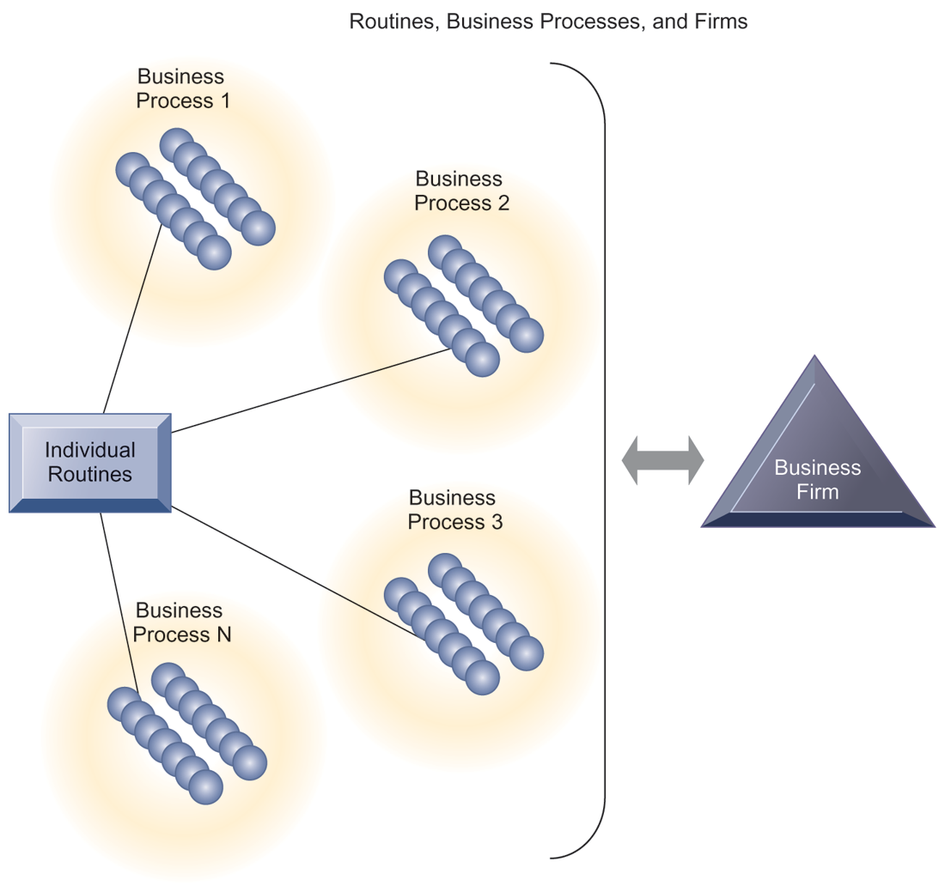
CHAPTER 3: INFORMATION SYSTEMS, ORGANIZATIONS,
AND STRATEGY
Organizations and Information Systems
ROUTINES, BUSINESS PROCESSES, AND FIRMS
All organizations are composed of individual routines and behaviors, a collection of which make up a business process. A collection of business processes make up the business firm. New information system applications require that individual routines and business processes change to achieve high levels of organizational performance.
FIGURE 3-4
© Prentice Hall 2011
Notes:
Explain to students that the blue spheres are individual routines, which together constitute a business process. A firm can be seen as a collection of these processes.

Slide 13
CHAPTER 3: INFORMATION SYSTEMS, ORGANIZATIONS,
AND STRATEGY
Organizations and Information Systems
Organizational politics
  Divergent viewpoints lead to political struggle, competition, and conflict
  Political resistance greatly hampers organizational change
© Prentice Hall 2011
Notes:
You could ask students to describe examples where organizational politics might hamper a firm’s ability to succeed, or examples where effectively managed organizational politics helps a company to undergo a smoother transition or make more intelligent decisions. Ask students to describe their personal experiences with “organizational politics.”

Slide 14
CHAPTER 3: INFORMATION SYSTEMS, ORGANIZATIONS,
AND STRATEGY
Organizations and Information Systems
Organizational culture:
  Encompasses set of assumptions that define goal and product
    What products the organization should produce
    How and where it should be produced
    For whom the products should be produced
  May be powerful unifying force as well as restraint on change
© Prentice Hall 2011
Notes:
Culture may seem like a pretty abstract idea to many students. On the other hand, students with work experiences will easily be able to describe the cultures of firms where they have worked. Ask students to describe organizational cultures they have experienced while on the job, or other areas of their lives. What kind of organizational culture do students prefer and why? Ask students to describe different kinds of cultures and what types of firms are more likely to have them.

Slide 15
CHAPTER 3: INFORMATION SYSTEMS, ORGANIZATIONS,
AND STRATEGY
Organizations and Information Systems
Organizational environments:
  Organizations and environments have a reciprocal relationship
  Organizations are open to, and dependent on, the social and physical environment
  Organizations can influence their environments
  Environments generally change faster than organizations
  Information systems can be an instrument of environmental scanning, act as a lens
© Prentice Hall 2011
Notes:
Explain that environmental scanning involves searching for and determining external changes that may require an organizational response. The current economic climate represents an example of external change that requires sweeping organizational responses to ensure survival.

Slide 16
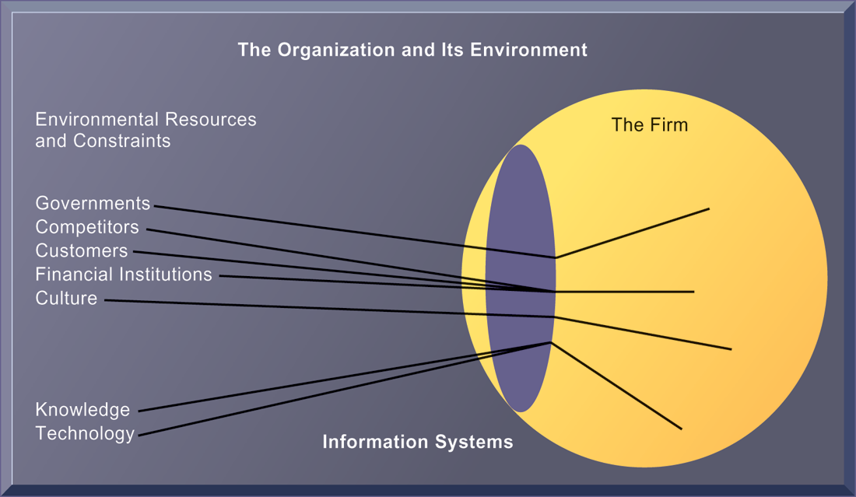
CHAPTER 3: INFORMATION SYSTEMS, ORGANIZATIONS,
AND STRATEGY
Organizations and Information Systems
ENVIRONMENTS AND ORGANIZATIONS HAVE A RECIPROCAL RELATIONSHIP
FIGURE 3-5
Environments shape what organizations can do, but organizations can influence their environments and decide to change environments altogether. Information technology plays a critical role in helping organizations perceive environmental change and in helping organizations act on their environment.
© Prentice Hall 2011
Notes:
This graphic further establishes information systems as the ‘lens’ of the firm, observing external factors and filtering information back in to the firm. To some extent, organizations only “see” what their systems will let them see. If systems are poorly built, they may blind managers to difficulties and problems.

Slide 17
CHAPTER 3: INFORMATION SYSTEMS, ORGANIZATIONS,
AND STRATEGY
Organizations and Information Systems
Disruptive technologies
  Technology that brings about sweeping change to businesses, industries, markets
  Examples: personal computers, word processing software, the Internet, the PageRank algorithm
  First movers and fast followers
    First movers – inventors of disruptive technologies
    Fast followers – firms with the size and resources to capitalize on that technology
© Prentice Hall 2011
Notes:
Ensure that students understand that the PageRank algorithm is the underlying technology behind Google search. Ask students if they can give examples of any first movers that invented a disruptive technology, yet failed to last (examples might include the Altair personal computer, the Netscape Navigator Internet browser, etc.).

Slide 18
CHAPTER 3: INFORMATION SYSTEMS, ORGANIZATIONS,
AND STRATEGY
Organizations and Information Systems
5 basic kinds of organizational structure
  Entrepreneurial:
    Small start-up business
  Machine bureaucracy:
    Midsize manufacturing firm
  Divisionalized bureaucracy:
    Fortune 500 firms
  Professional bureaucracy:
    Law firms, school systems, hospitals
  Adhocracy:
    Consulting firms
© Prentice Hall 2011
Notes:
Do students agree with the classification of these types of organizational structure? Can they come up with examples for each type of organization?

Slide 19
CHAPTER 3: INFORMATION SYSTEMS, ORGANIZATIONS,
AND STRATEGY
Organizations and Information Systems
Other organizational features
  Goals
  Constituencies
  Leadership styles
  Tasks
  Surrounding environments
© Prentice Hall 2011
Notes:
Ask students to give some examples of each organizational feature listed above. For example, different organizations (prisons, businesses, colleges) have different types of goals (coercive, utilitarian, normative, respectively).

Slide 20
CHAPTER 3: INFORMATION SYSTEMS, ORGANIZATIONS,
AND STRATEGY
How Information Systems Impact Organizations and Business Firms
Economic impacts
  IT changes relative costs of capital and the costs of information
  Information systems technology is a factor of production, like capital and labor
  IT affects the cost and quality of information and changes economics of information
    Information technology helps firms contract in size because it can reduce transaction costs (the cost of participating in markets)
      Outsourcing
© Prentice Hall 2011
Notes:
IT figures to replace the function of more middle managers as time passes, as well as reduce the need for other forms of capital (buildings, machinery). Ensure that students understand what is meant by ‘economics of information’ and why outsourcing is a possibility due to IT.

Slide 21
CHAPTER 3: INFORMATION SYSTEMS, ORGANIZATIONS,
AND STRATEGY
How Information Systems Impact Organizations and Business Firms
Transaction cost theory
  Firms seek to economize on transaction costs (the costs of participating in markets)
    Vertical integration, hiring more employees, buying suppliers and distributors
  IT lowers market transaction costs for a firm, making it worthwhile for firms to transact with other firms rather than grow the number of employees
© Prentice Hall 2011
Notes:
Explain that using the market can be expensive. If you depend on the market, rather than hiring employees, you will need to search for talent, research the quality of providers and workers, write contracts for work to be performed, monitor the work, and so forth. When participation in markets is expensive, firms would rather hire employees to accomplish their work. But the Internet makes it less expensive to use the marketplace. With the Internet, firms find it more cost effective to use the marketplace and contract for work in a market, rather than hire employees. Ask your students why the Internet can make participating in markets less expensive than before.

Slide 22
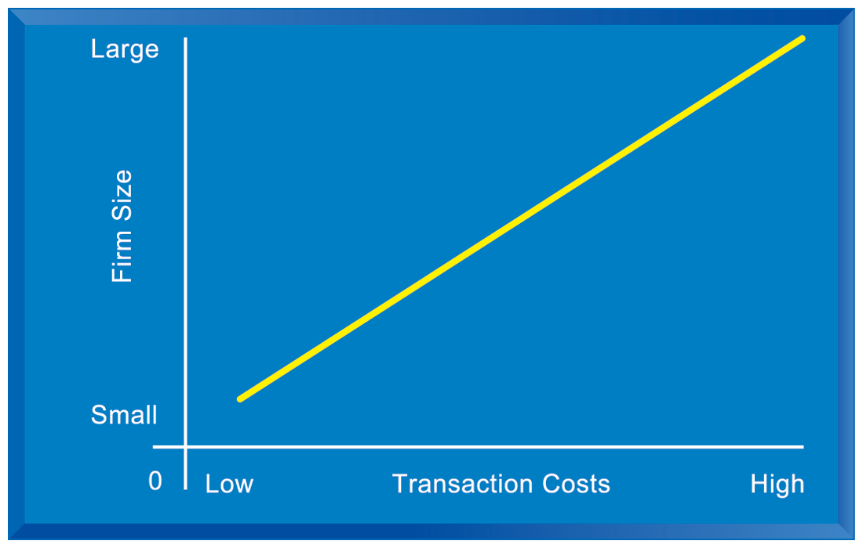
CHAPTER 3: INFORMATION SYSTEMS, ORGANIZATIONS,
AND STRATEGY
How Information Systems Impact Organizations and Business Firms
THE TRANSACTION COST THEORY OF THE IMPACT OF INFORMATION
TECHNOLOGY ON THE ORGANIZATION
FIGURE 3-6
Firms traditionally grew in size to reduce market transaction costs. IT potentially reduces the firms market transaction costs. This means firms can outsource work using the market, reduce their employee head count and still grow revenues, relying more on outsourcing firms and external contractors.
© Prentice Hall 2011
Notes:
As the costs of participating in markets rises (transaction costs), firms hire more employees to do the work in-house. IT lowers transaction costs. This can result in firms shrinking in size (reduced employment), but still maintaining or even increasing revenues.

Slide 23
CHAPTER 3: INFORMATION SYSTEMS, ORGANIZATIONS,
AND STRATEGY
How Information Systems Impact Organizations and Business Firms
Agency theory:
  Firm is nexus of contracts among self-interested parties requiring supervision
  Firms experience agency costs (the cost of managing and supervising) which rise as firm grows
  IT can reduce agency costs, making it possible for firms to grow without adding to the costs of supervising, and without adding employees
© Prentice Hall 2011
Notes:
By characterizing employees as independent agents requiring constant supervision, agency theory underscores a key reason that costs increase as firms grow in size and scope – the need to expend more effort managing their employees.

Slide 24
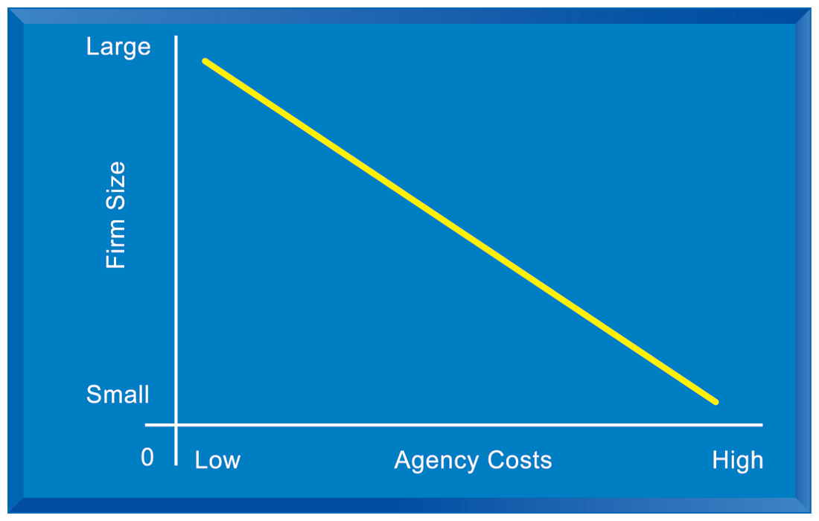
CHAPTER 3: INFORMATION SYSTEMS, ORGANIZATIONS,
AND STRATEGY
How Information Systems Impact Organizations and Business Firms
THE AGENCY THEORY OF THE IMPACT OF INFORMATION
TECHNOLOGY ON THE ORGANIZATION
FIGURE 3-7
As firms grow in size and complexity, traditionally they experience rising agency costs.
© Prentice Hall 2011
Notes:
Agency costs rise as firms take on more employees. IT enables firms to economize on managers through better coordination and communication. This allows firms to grow revenues while maintaining the same size. Figures 3-6 and 3-7 are driving home the point that information technology has a direct effect on the underlying cost structure of the firm. IT enables small companies to act like big companies, and enables large companies to shrink in headcount while expanding revenues. The reason is that IT makes managers, and the management function, much more efficient. Ask students if they can think of any examples of this technology impact.

Slide 25
CHAPTER 3: INFORMATION SYSTEMS, ORGANIZATIONS,
AND STRATEGY
How Information Systems Impact Organizations and Business Firms
Organizational and behavioral impacts
  IT flattens organizations
    Decision making pushed to lower levels
    Fewer managers needed (IT enables faster decision making and increases span of control)
  Postindustrial organizations
    Organizations flatten because in postindustrial societies, authority increasingly relies on knowledge and competence rather than formal positions
© Prentice Hall 2011
Notes:
Ask students to explain what is meant by authority relying on knowledge and competence rather than formal positions. Why might this ‘flatten’ the organization? The idea here is that with sufficient IT, competent workers will be able to accomplish more on their own than they would under a more hierarchical arrangement.

Slide 26
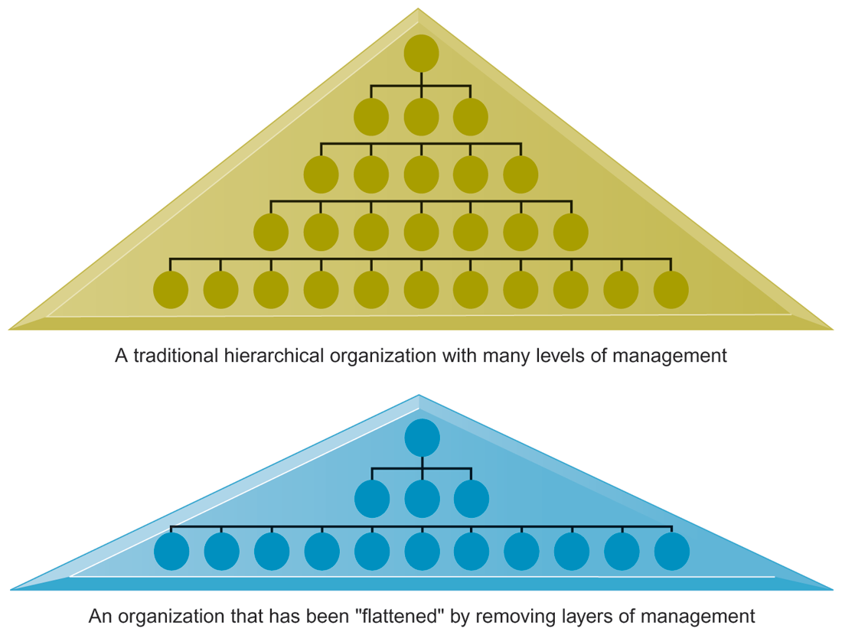
CHAPTER 3: INFORMATION SYSTEMS, ORGANIZATIONS,
AND STRATEGY
How Information Systems Impact Organizations and Business Firms
FLATTENING ORGANIZATIONS
Information systems can reduce the number of levels in an organization by providing managers with information to supervise larger numbers of workers and by giving lower-level employees more decision-making authority.
FIGURE 3-8
© Prentice Hall 2011
Notes:
Ask students to explain some of the benefits of the flattened organization as opposed to the more complicated hierarchy in the top of the diagram. Information travels through fewer levels to its intended recipients; there are fewer managers, so agency costs are smaller, and firms can act faster (less decision delay).

Slide 27
CHAPTER 3: INFORMATION SYSTEMS, ORGANIZATIONS,
AND STRATEGY
How Information Systems Impact Organizations and Business Firms
Organizational resistance to change
  Information systems become bound up in organizational politics because they influence access to a key resource – information
  Information systems potentially change an organization’s structure, culture, politics, and work
  Most common reason for failure of large projects is due to organizational and political resistance to change
© Prentice Hall 2011
Notes:
Explain what is meant by changes in culture and politics of the firm. For example, workers may resist changes that disrupt their routines. Also explain to students that as important as technical understanding of information systems may be for potential managers, it is equally important to understand the people and organizational structures and customs affected by information systems.

Slide 28
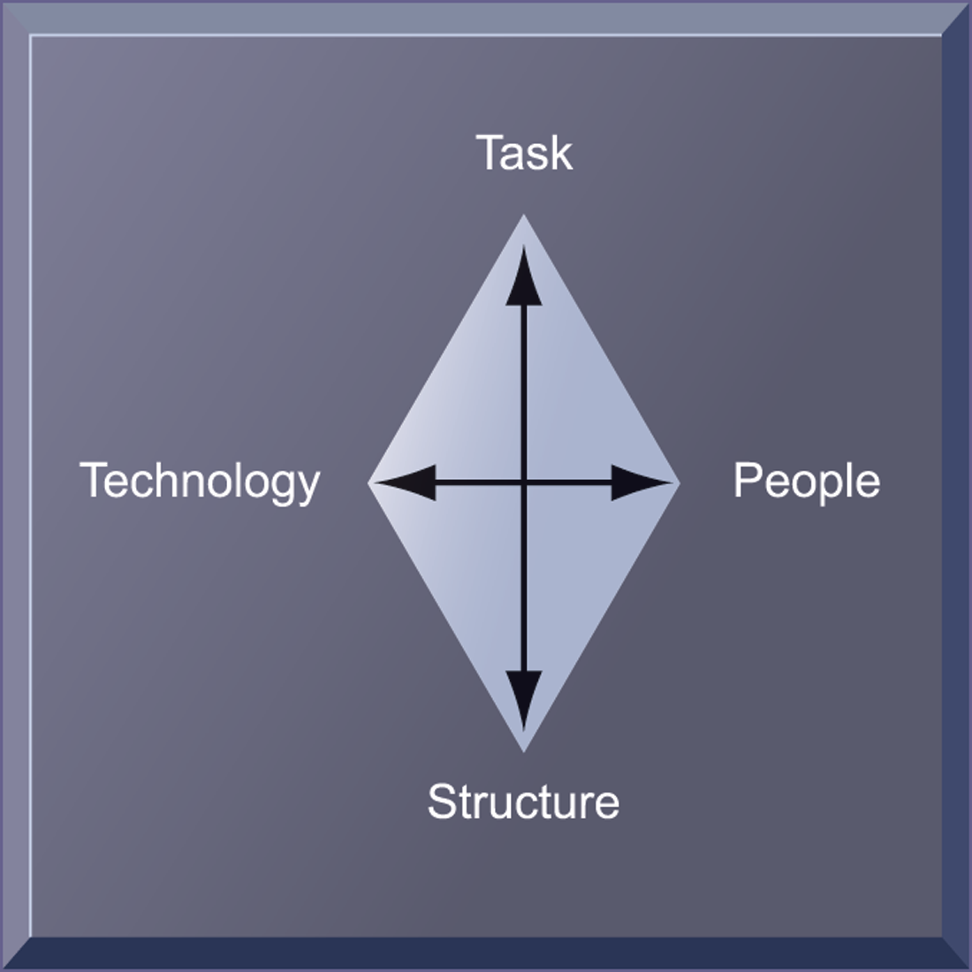
CHAPTER 3: INFORMATION SYSTEMS, ORGANIZATIONS,
AND STRATEGY
How Information Systems Impact Organizations and Business Firms
ORGANIZATIONAL RESISTANCE AND THE MUTUALLY ADJUSTING RELATIONSHIP BETWEEN TECHNOLOGY AND THE ORGANIZATION
Implementing information systems has consequences for task arrangements, structures, and people. According to this model, to implement change, all four components must be changed simultaneously.
FIGURE 3-9
© Prentice Hall 2011
Notes:
The diamond shape in the figure represents the mutual relationship between the concepts shown. You could emphasize that implementing a new system might be like changing the diamond into a square, thus requiring some degree of change on the part of all four participants in the relationship.

Slide 29
CHAPTER 3: INFORMATION SYSTEMS, ORGANIZATIONS,
AND STRATEGY
How Information Systems Impact Organizations and Business Firms
The Internet and organizations
  The Internet increases the accessibility, storage, and distribution of information and knowledge for organizations
  The Internet can greatly lower transaction and agency costs
    Example: Large firm delivers internal manuals to employees via a corporate Web site, saving millions of dollars in distribution costs
© Prentice Hall 2011
Notes:
The Internet should also have a flattening effect on many organizations. Can students describe any businesses that have become more efficient and flat thanks to successful incorporation of the Internet in their operations? Some older students may remember the “bad old days” when seven or more levels of management needed to decide even simple issues in a typical firm.

Slide 30
CHAPTER 3: INFORMATION SYSTEMS, ORGANIZATIONS,
AND STRATEGY
How Information Systems Impact Organizations and Business Firms
Central organizational factors to consider when planning a new system:
  Environment
  Structure
    Hierarchy, specialization, routines, business processes
  Culture and politics
  Type of organization and style of leadership
  Main interest groups affected by system; attitudes of end users
  Tasks, decisions, and business processes the system will assist
© Prentice Hall 2011
Notes:
Ask students to consider the results of an information system implemented without properly considering each of the above factors. For example, an information system designed without an understanding of the company’s culture and politics is likely to be unpopular, perhaps forcing employees to drastically deviate from their previous routines.

Slide 31
CHAPTER 3: INFORMATION SYSTEMS, ORGANIZATIONS,
AND STRATEGY
Using Information Systems to Achieve Competitive Advantage
Why do some firms become leaders in their industry?
Michael Porter’s competitive forces model
  Provides general view of firm, its competitors, and environment
  Five competitive forces shape fate of firm
    Traditional competitors
    New market entrants
    Substitute products and services
    Customers
    Suppliers
© Prentice Hall 2011
Notes:
Porter’s competitive forces model is intended to explain why some firms do better than others. Do students believe that this model captures this idea effectively? Which factor is most important to a firm’s success? You can make a list of five well-known firms on the blackboard or screen and ask students for each firm which do they think are the most important competitive forces.

Slide 32
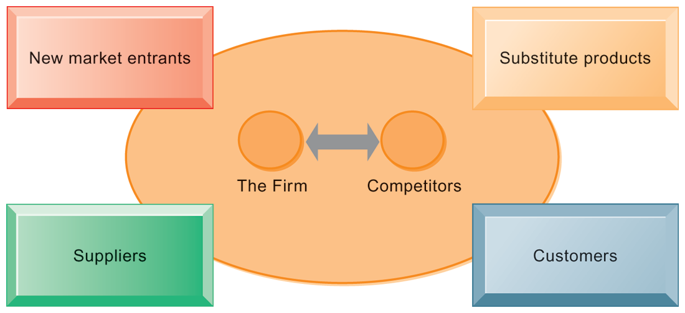
CHAPTER 3: INFORMATION SYSTEMS, ORGANIZATIONS,
AND STRATEGY
Using Information Systems to Achieve Competitive Advantage
PORTER’S COMPETITIVE FORCES MODEL
FIGURE 3-10
In Porter’s competitive forces model, the strategic position of the firm and its strategies are determined not only by competition with its traditional direct competitors but also by four other forces in the industry’s environment: new market entrants, substitute products, customers, and suppliers.
© Prentice Hall 2011
Notes:
Notice that in the graphic, competitors are represented differently than the other four competitive forces influencing a firm. Why do students think this is the case? One answer might be that competitors are firms in the same industry and are under similar pressures as other firms in the industry.

Slide 33
CHAPTER 3: INFORMATION SYSTEMS, ORGANIZATIONS,
AND STRATEGY
Using Information Systems to Achieve Competitive Advantage
Traditional competitors
  All firms share market space with competitors who are continuously devising new products, services, efficiencies, switching costs
New market entrants
  Some industries have high barriers to entry, e.g. computer chip business
  New companies have new equipment, younger workers, but little brand recognition
© Prentice Hall 2011
Notes:
Ask students to name different industries and describe the benefits and drawbacks of being a new market entrant in each industry.

Slide 34
CHAPTER 3: INFORMATION SYSTEMS, ORGANIZATIONS,
AND STRATEGY
Using Information Systems to Achieve Competitive Advantage
Substitute products and services
  Substitutes customers might use if your prices become too high, e.g. iTunes substitutes for CDs
Customers
  Can customers easily switch to competitor’s products? Can they force businesses to compete on price alone in transparent marketplace?
Suppliers
  Market power of suppliers when firm cannot raise prices as fast as suppliers
© Prentice Hall 2011
Notes:
Ask students to name different businesses and describe whether or not customers have great control over the business or vice versa, or whether substitute products are a large or insignificant threat to the success of the business.

Slide 35
CHAPTER 3: INFORMATION SYSTEMS, ORGANIZATIONS,
AND STRATEGY
Using Information Systems to Achieve Competitive Advantage
Four generic strategies for dealing with competitive forces, enabled by using IT
  Low-cost leadership
  Product differentiation
  Focus on market niche
  Strengthen customer and supplier intimacy
© Prentice Hall 2011
Notes:
Here you can make a list of five well-known firms and then analyze with students the major thrust of their strategy. Wal-Mart is a good example to start with because of its emphasis on low-cost leadership.

Slide 36
CHAPTER 3: INFORMATION SYSTEMS, ORGANIZATIONS,
AND STRATEGY
Using Information Systems to Achieve Competitive Advantage
Low-cost leadership
  Produce products and services at a lower price than competitors while enhancing quality and level of service
  Examples: Wal-Mart
Product differentiation
  Enable new products or services, greatly change customer convenience and experience
  Examples: Google, Nike, Apple
© Prentice Hall 2011
Notes:
Do students believe it is possible to design information systems that focus both on low-cost leadership and product differentiation? Some may say it is with sufficient planning and innovation; perhaps a new product is even cheaper to produce than older ones. Some may say that the investment in innovation required for product differentiation precludes that firm from maintaining low-cost leadership.

Slide 37
CHAPTER 3: INFORMATION SYSTEMS, ORGANIZATIONS,
AND STRATEGY
Using Information Systems to Achieve Competitive Advantage
Focus on market niche
  Use information systems to enable a focused strategy on a single market niche; specialize
  Example: Hilton Hotels
Strengthen customer and supplier intimacy
  Use information systems to develop strong ties and loyalty with customers and suppliers; increase switching costs
  Example: Netflix, Amazon
© Prentice Hall 2011
Notes:
You could ask students to provide other examples from their own experience of companies that exemplify strong focus on market niche as well as excellent customer and supplier intimacy.

Slide 38
CHAPTER 3: INFORMATION SYSTEMS, ORGANIZATIONS,
AND STRATEGY
Using Information Systems to Achieve Competitive Advantage
HOW MUCH DO CREDIT CARD COMPANIES KNOW ABOUT YOU?
What competitive strategy are the credit card companies pursuing? How do information systems support that strategy?
What are the business benefits of analyzing customer purchase data and constructing behavioral profiles?
Are these practices by credit card companies ethical? Are they an invasion of privacy? Why or why not?
© Prentice Hall 2011
Notes:
Credit card companies are an interesting industry to look at from a competitive analysis point of view. There are really just three companies of any size: Visa, MasterCard and American Express. There are of course store cards provided by several credit card banking and processing firms. How do the big three compete against one another? How do your students come to have one or more of these companies’ cards? How does the use of behavioral targeting fit in with the strategies of these companies? What is their strategy? How does IS play a role in these strategies?

Slide 39
CHAPTER 3: INFORMATION SYSTEMS, ORGANIZATIONS,
AND STRATEGY
Using Information Systems to Achieve Competitive Advantage
The Internet’s impact on competitive advantage
  Transformation, destruction, threat to some industries
    E.g. travel agency, printed encyclopedia, newspaper
  Competitive forces still at work, but rivalry more intense
  Universal standards allow new rivals, entrants to market
  New opportunities for building brands and loyal customer bases
© Prentice Hall 2011
Notes:
Do students believe it is easier or harder to gain a competitive advantage via the Internet as opposed to more traditional means? Table 3-5 describes the impact of the Internet on various competitive forces.

Slide 40
CHAPTER 3: INFORMATION SYSTEMS, ORGANIZATIONS,
AND STRATEGY
Using Information Systems to Achieve Competitive Advantage
IS THE IPAD A DISRUPTIVE TECHNOLOGY?
Evaluate the impact of the iPad using Porter’s competitive forces model.
What makes the iPad a disruptive technology? Who are likely to be the winners and losers if the iPad becomes a hit? Why?
What effects will the iPad have on the business models of Apple, content creators, and distributors?
© Prentice Hall 2011
Notes:
Ask students if they have read electronic books and textbooks and what devices they have used – Kindle, Nook, iPad, Sony Reader, PC, etc. Are all of these also disruptive technologies? What other recent technologies can be seen as or have the potential to be disruptive? Some candidates are Netflix streaming movies, Google TV, Apple TV, and Vook books (Vook.com sells enhanced books with both text and videos).

Slide 41
CHAPTER 3: INFORMATION SYSTEMS, ORGANIZATIONS,
AND STRATEGY
Using Information Systems to Achieve Competitive Advantage
Business value chain model
  Views firm as series of activities that add value to products or services
  Highlights activities where competitive strategies can best be applied
    Primary activities vs. support activities
  At each stage, determine how information systems can improve operational efficiency and improve customer and supplier intimacy
  Utilize benchmarking, industry best practices
© Prentice Hall 2011
Notes:
How does the value chain model differ from the Porter model? (It offers more specific detail about what exactly to do to achieve competitive advantages.) How do primary activities differ from support activities?

Slide 42
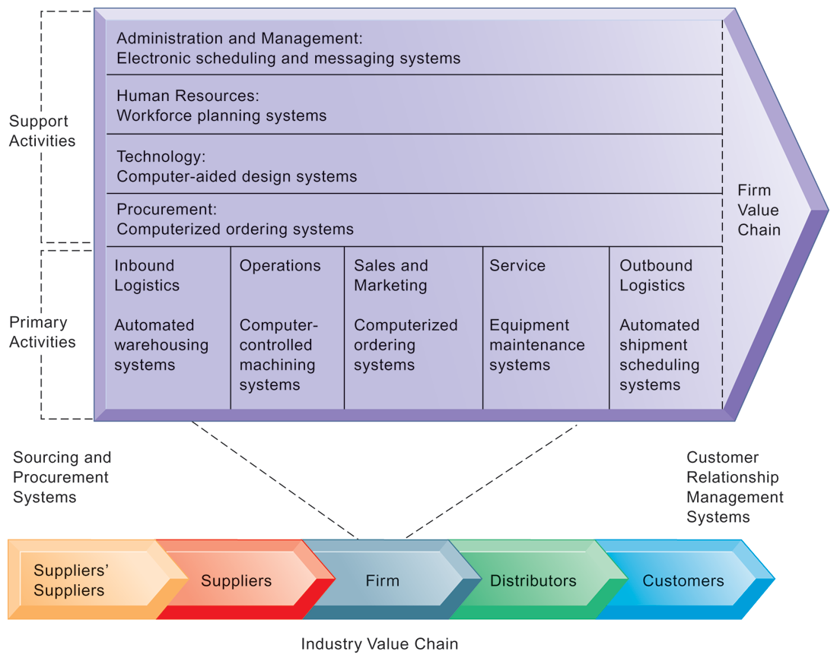
CHAPTER 3: INFORMATION SYSTEMS, ORGANIZATIONS,
AND STRATEGY
Using Information Systems to Achieve Competitive Advantage
THE VALUE CHAIN MODEL
This figure provides examples of systems for both primary and support activities of a firm and of its value partners that can add a margin of value to a firm’s products or services.
FIGURE 3-11
© Prentice Hall 2011
Notes:
Emphasize the relationship between the primary and support activities of this firm and explain how information systems are critical to the success of each activity.

Slide 43
CHAPTER 3: INFORMATION SYSTEMS, ORGANIZATIONS,
AND STRATEGY
Using Information Systems to Achieve Competitive Advantage
Value web:
  Collection of independent firms using highly synchronized IT to coordinate value chains to produce product or service collectively
  More customer driven, less linear operation than traditional value chain
© Prentice Hall 2011
Notes:
Explain that a value web extends beyond the boundaries of an individual firm and represents the coordination of value chains across multiple independent firms. A value web is flexible and adapts to changes in supply and demand and changing market conditions.

Slide 44
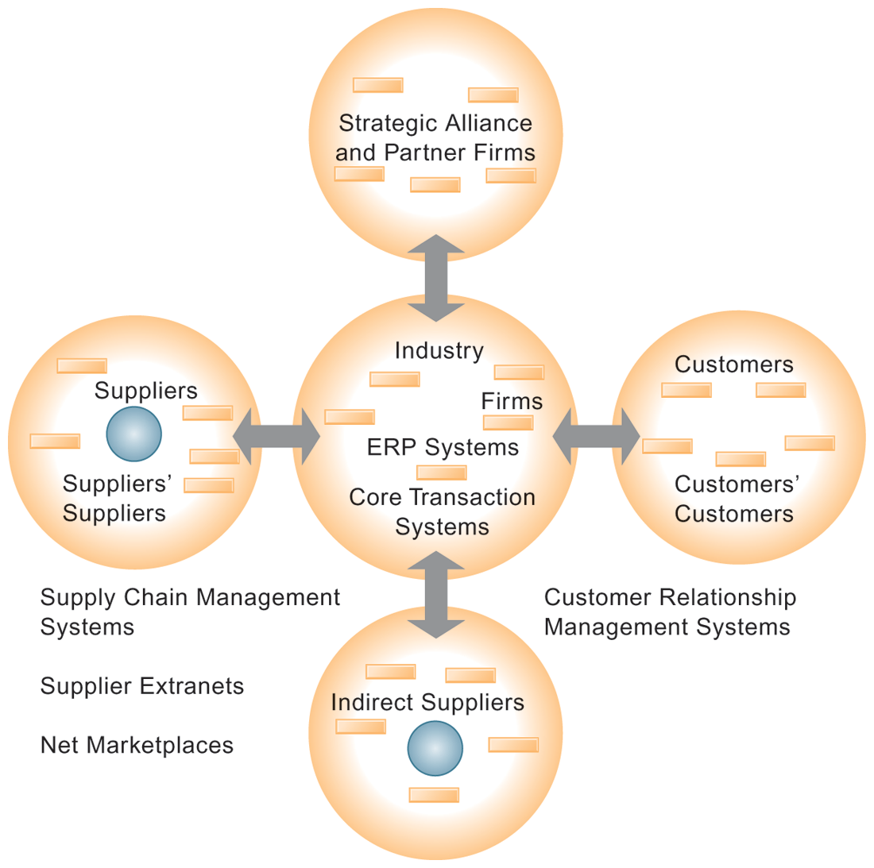
CHAPTER 3: INFORMATION SYSTEMS, ORGANIZATIONS,
AND STRATEGY
Using Information Systems to Achieve Competitive Advantage
THE VALUE WEB
The value web is a networked system that can synchronize the value chains of business partners within an industry to respond rapidly to changes in supply and demand.
FIGURE 3-12
© Prentice Hall 2011
Notes:
Ask students why a model like the one displayed in the figure might be more likely to adapt quickly to changes in supply and demand. Also emphasize the networking between the different segments of the value web.

Slide 45
CHAPTER 3: INFORMATION SYSTEMS, ORGANIZATIONS,
AND STRATEGY
Using Information Systems to Achieve Competitive Advantage
Information systems can improve overall performance of business units by promoting synergies and core competencies
  Synergies
    When output of some units used as inputs to others, or organizations pool markets and expertise
    Example: merger of Bank of NY and JPMorgan Chase
    Purchase of YouTube by Google
© Prentice Hall 2011
Notes:
Explain that information technology’s role in promoting synergy is often tying together operations of disparate business units so that they can act as a whole. Why might this lead to reduced costs and increased efficiency?

Slide 46
CHAPTER 3: INFORMATION SYSTEMS, ORGANIZATIONS,
AND STRATEGY
Using Information Systems to Achieve Competitive Advantage
Core competencies
  Activity for which firm is world-class leader
  Relies on knowledge, experience, and sharing this across business units
  Example: Procter & Gamble’s intranet and directory of subject matter experts
© Prentice Hall 2011
Notes:
Can students name any other notable examples of core competencies among firms? (Google: search, Microsoft: office productivity software; Intel processors, etc.)

Slide 47
CHAPTER 3: INFORMATION SYSTEMS, ORGANIZATIONS,
AND STRATEGY
Using Information Systems to Achieve Competitive Advantage
Network-based strategies
  Take advantage of firm’s abilities to network with each other
  Include use of:
    Network economics
    Virtual company model
    Business ecosystems
© Prentice Hall 2011
Notes:
Examples of firms that use this type of strategy to achieve an advantage are eBay and iVillage. Many other companies are following suit in using a network-based strategy – can students name any? eBay, iVillage, and social networking firms like Facebook, are based on networks of millions of users. These companies have used the Web and Internet communication tools to build communities. The more people who join these communities, the more benefit members receive.

Slide 48
CHAPTER 3: INFORMATION SYSTEMS, ORGANIZATIONS,
AND STRATEGY
Using Information Systems to Achieve Competitive Advantage
Traditional economics: Law of diminishing returns
  The more any given resource is applied to production, the lower the marginal gain in output, until a point is reached where the additional inputs produce no additional outputs
Network economics:
  Marginal cost of adding new participant almost zero, with much greater marginal gain
  Value of community grows with size
  Value of software grows as installed customer base grows
© Prentice Hall 2011
Notes:
Explain the difference between these two schools of economics. What aspect of network economics allows value to continue to increase with the size of the community?

Slide 49
CHAPTER 3: INFORMATION SYSTEMS, ORGANIZATIONS,
AND STRATEGY
Using Information Systems to Achieve Competitive Advantage
Virtual company strategy
  Virtual company uses networks to ally with other companies to create and distribute products without being limited by traditional organizational boundaries or physical locations
  E.g. Li & Fung manages production, shipment of garments for major fashion companies, outsourcing all work to over 7,500 suppliers
© Prentice Hall 2011
Notes:
Explain to students that companies like this are ‘virtual’ because they do not actually own any factories, machines, or other similar infrastructure. Instead, they offer a series of services, aided by information systems and uninhibited by geographical boundaries.

Slide 50
CHAPTER 3: INFORMATION SYSTEMS, ORGANIZATIONS,
AND STRATEGY
Using Information Systems to Achieve Competitive Advantage
Business ecosystems
  Industry sets of firms providing related services and products
    Microsoft platform used by thousands of firms
    Wal-Mart’s order entry and inventory management
  Keystone firms: Dominate ecosystem and create platform used by other firms
  Niche firms: Rely on platform developed by keystone firm
  Individual firms can consider how IT will help them become profitable niche players in larger ecosystems
© Prentice Hall 2011
Notes:
Can students see the similarities between business ecosystems and value webs? Can they appreciate the key difference (that business ecosystems extend across industries as opposed to just firms within the same industry)?

Slide 51
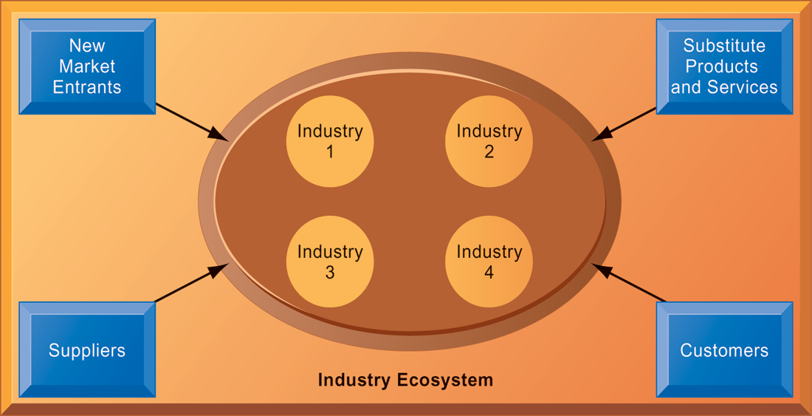
CHAPTER 3: INFORMATION SYSTEMS, ORGANIZATIONS,
AND STRATEGY
Using Information Systems to Achieve Competitive Advantage
AN ECOSYSTEM STRATEGIC MODEL
FIGURE 3-13
The digital firm era requires a more dynamic view of the boundaries among industries, firms, customers, and suppliers, with competition occurring among industry sets in a business ecosystem. In the ecosystem model, multiple industries work together to deliver value to the customer. IT plays an important role in enabling a dense network of interactions among the participating firms.
© Prentice Hall 2011
Notes:
Emphasize how important IT is in bringing disparate industries together to deliver value to the customer. What are the challenges of coordinating the flow of information across, for example, four different industries, as shown in the figure?

Slide 52
CHAPTER 3: INFORMATION SYSTEMS, ORGANIZATIONS,
AND STRATEGY
Using Information Systems for Competitive Advantage: Management Issues
Sustaining competitive advantage
  Because competitors can retaliate and copy strategic systems, competitive advantage is not always sustainable; systems may become tools for survival
Performing strategic systems analysis
  What is structure of industry?
  What are value chains for this firm?
Managing strategic transitions
  Adopting strategic systems requires changes in business goals, relationships with customers and suppliers, and business processes
© Prentice Hall 2011
Notes:
Emphasize the importance and difficulty of aligning information technology with the business. What does this phrase mean? It seems pretty simple. Why do so many companies fail at this critical task? Can students think of any other important questions that management should ask about their company before designing their IT systems? What is a solution for the fact that many competitive advantages can be copied? This fact highlights the importance of continuous innovation in order to stay ahead.

Slide 53

All rights reserved. No part of this publication may be reproduced, stored in a retrieval system, or transmitted, in any form or by any means, electronic, mechanical, photocopying, recording, or otherwise, without the prior written permission of the publisher. Printed in the United States of America.
Copyright © 2011 Pearson Education, Inc.
Publishing as Prentice Hall

